Slide 1

Parameter Efficient Tuning
11-667: LARGE LANGUAGE MODELS: METHODS AND APPLICATIONS

Slide 2
Announcements
If you still don’t have a team for the project, come see me after class.
For issues with HW1 Question 3.1, see my post recent note on Piazza.
Do you want feedback on your project idea? Fill out the form to ask for feedback by EOD day.
Chenyan’s office hours today are canceled.

Slide 3
You want to use an LM for some task for which you’ve collected a dataset of examples.
What do you do?
Prompt engineering
  Doesn’t always work
  Tedious to find a good prompt
Finetune the full LM on your data
  Expensive
  Overfitting / catastrophic forgetting on small datasets
  Need to store one full set of model weights per task.
Parameter-efficient tuning

Slide 4
What is parameter efficient tuning?
Rather than finetuning the entire model, we finetune only small amounts of weights.
In this lecture, we’ll break PETM techniques into roughly three categories.

Slide 5
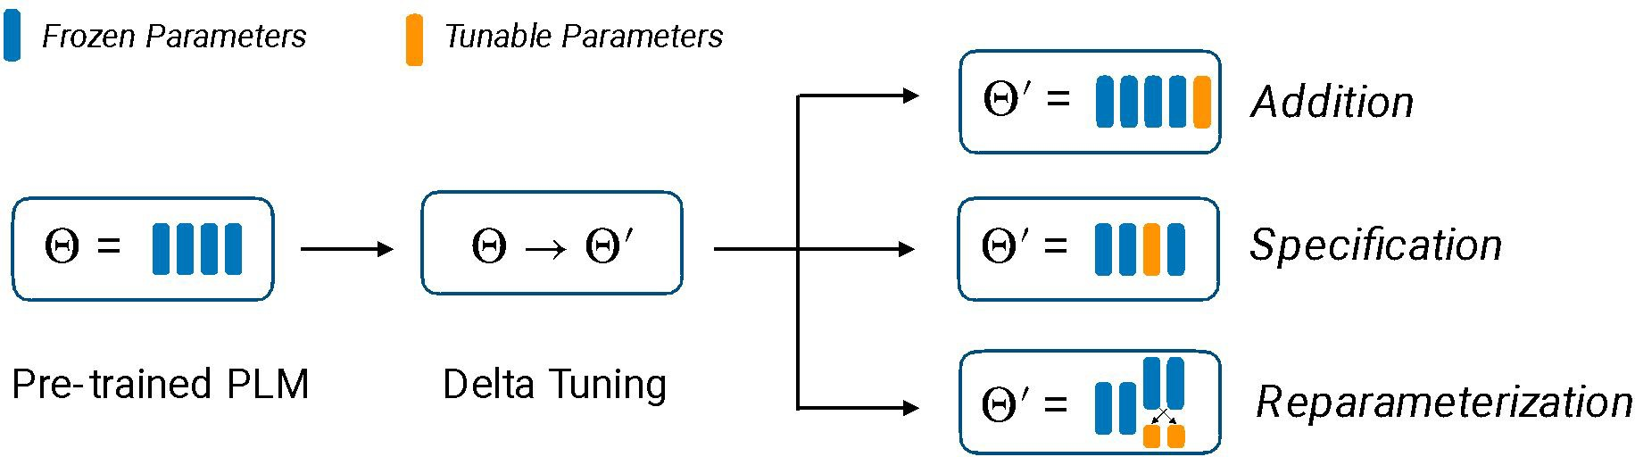
1. Addition: What if we introduce additional trainable parameters to the neural network and just train those?
Specification: What if we pick a small subset of the parameters of the neural network and just tune those?
Reparameterization: What if we re-parameterize the model into something that is more efficient to train?
PETM

Slide 6
What is parameter efficient tuning?
Ideas we will cover
AutoPrompt
Prompt tuning
LoRa
(IA)³

Slide 7
What if we introduce additional trainable parameters to the neural network and just train those?
Methods we’ll discuss: prompt tuning, prefix tuning, adapters, and compacters

Slide 8
Intuition for Prompt Tuning
Prompt engineering sucks.
If we have a bunch of examples of the task, why can’t we train a neural network to produce a good prompt for the task.
“The Power of Scale for Parameter-Efficient Prompt Tuning.” Lester et al. 2021.

Slide 9


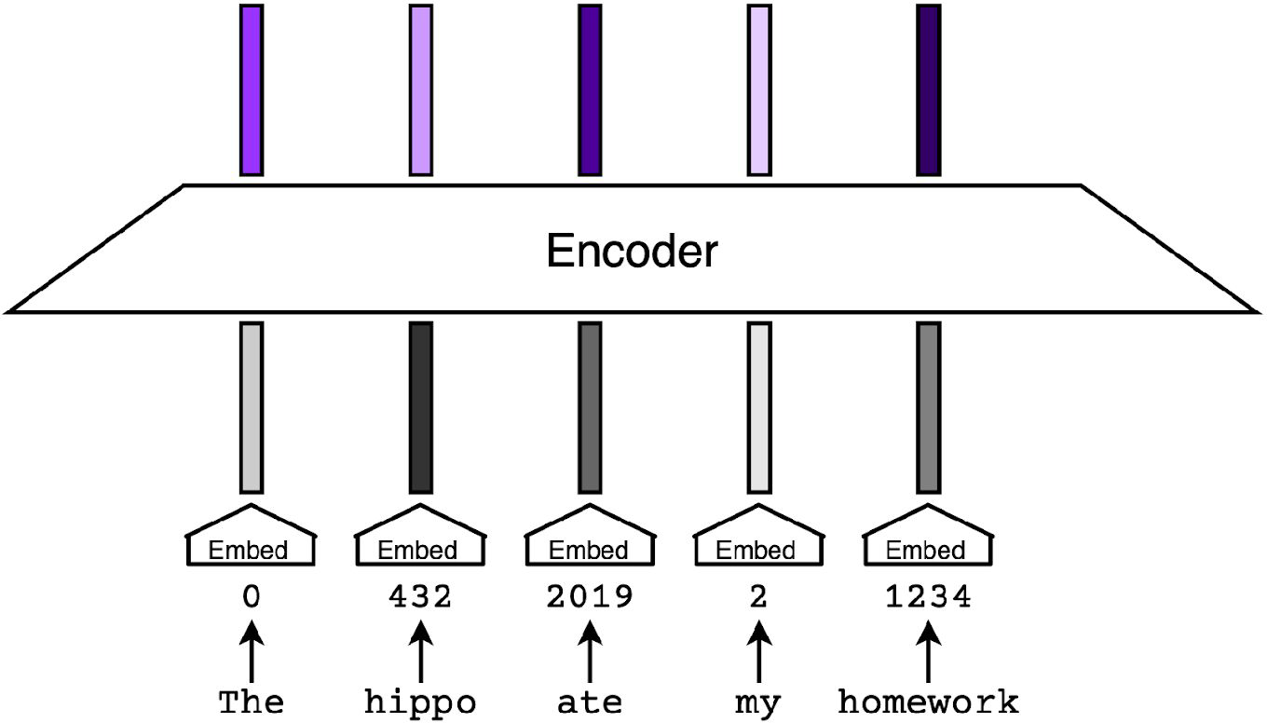
Prompt Tuning Method
What we want: a NN that is trained on examples of our task and produces a sequence of tokens we can prepend to our LLM query, causing the LLM to do the task in question.
In practice, optimizing over discrete tokens is hard.
What we do instead: a NN that outputs a sequence of embeddings we can prepend to our query to the LLM, causing the LLM to do the task.
“The Power of Scale for Parameter-Efficient Prompt Tuning.” Lester et al. 2021.

Slide 10
Prompt Tuning Method
Finetune T5 to act a bit more like a traditional language model.
  This only needs to be done once, and empirically makes prompt tuning working better.
  This is probably because the span-corruption objective T5 was originally trained with isn’t amenable to prompting.
Freeze the weights of T5. Set the first k input embeddings to be learnable.
  k is a hyperparameter up to the choice of the implementer.
Initialize the k learnable embeddings. Some options include:
  Random initialization
  Initialize to values drawn from the vocabulary embedding matrix
Train on your task specific data,
“The Power of Scale for Parameter-Efficient Prompt Tuning.” Lester et al. 2021.

Slide 11
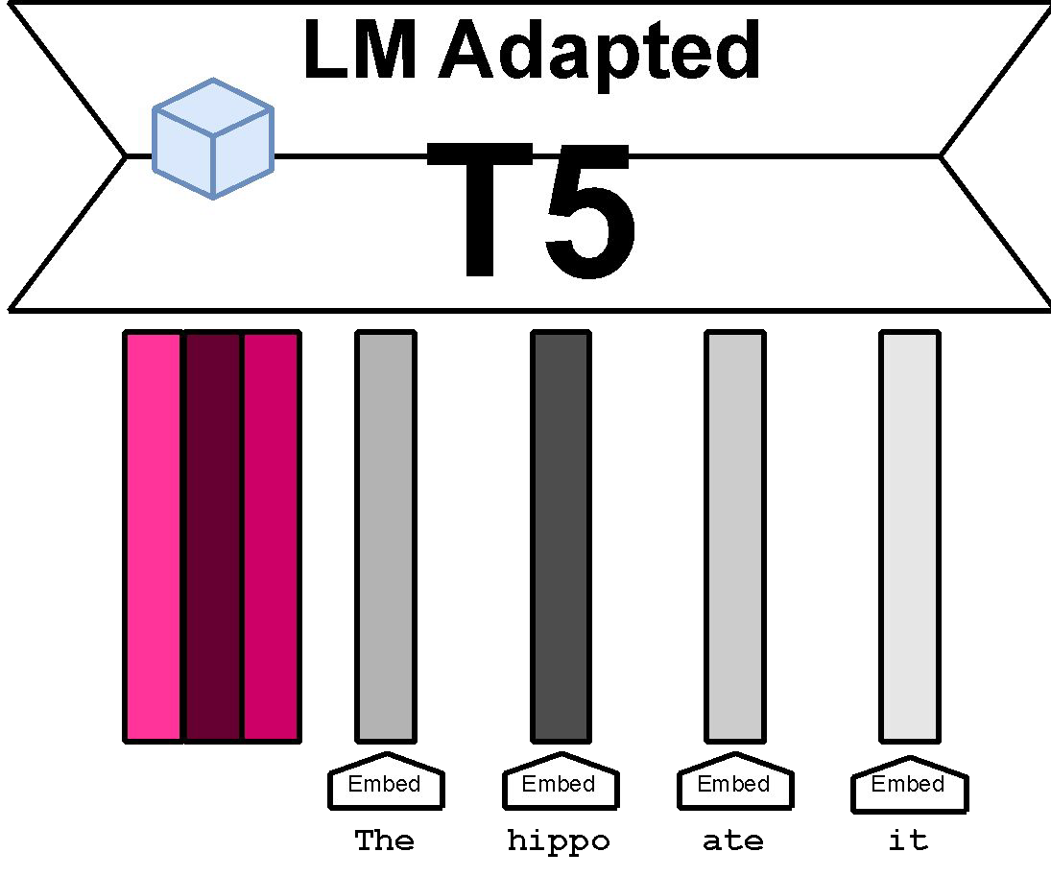
Prompt Tuning Method

Slide 12
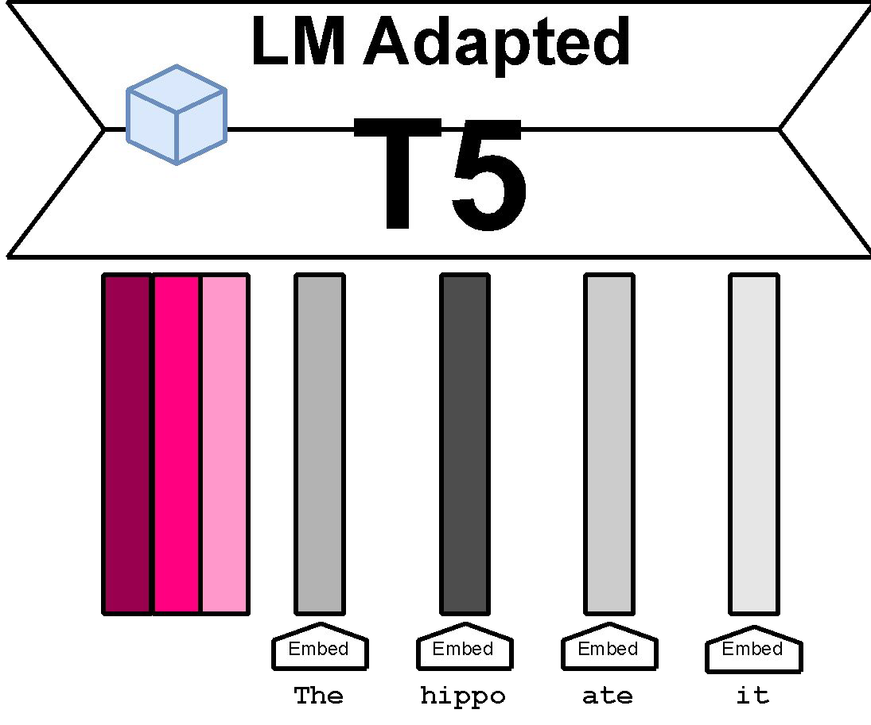
Prompt Tuning Method

Slide 13
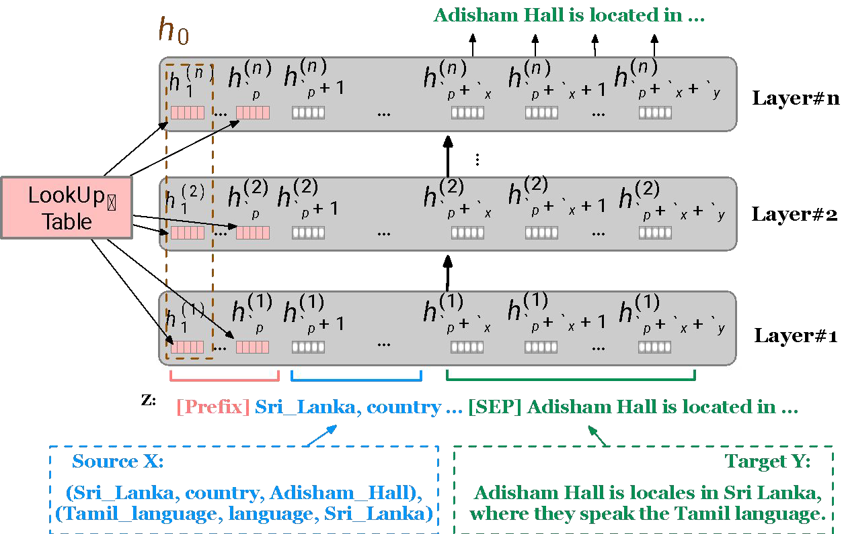
Prefix Tuning
Same idea as prompt tuning, except that the learned prefix is appended not just to the input embeddings, but rather at each layer of the Transformer.
“Prefix-Tuning: Optimizing Continuous Prompts for Generation.” Li and Liang. 2021.

Slide 14
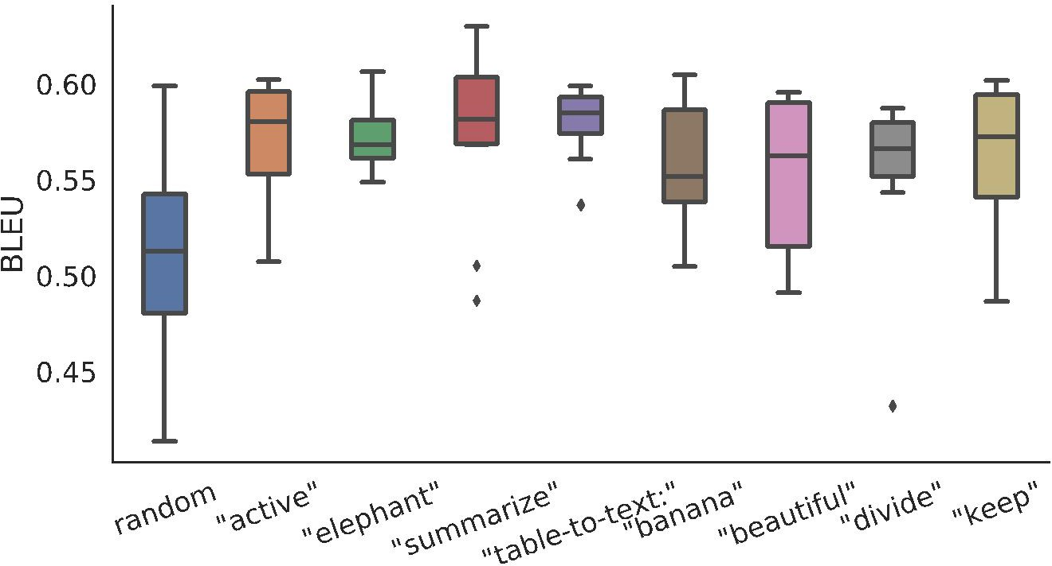
How to initialize the prefix?
Initializing to real embeddings seems to work better than random initialization.
“Prefix-Tuning: Optimizing Continuous Prompts for Generation.” Li and Liang. 2021.

Slide 15
Advantages of Prefix/Prompt Tuning
The learned embeddings tend to be relatively small, just a few megabytes or less.
  It is cheap to keep around one set of embeddings per task.
The pre-trained LLM can be loaded into memory (such as on a server), and at inference time, the appropriate task-specific embeddings can be passed in.
  Example use case: User customization

Slide 16
Pitfalls of Prefix and Prompt Tuning
In practice, these methods tend to converge significantly slower than full parameter fine-tuning.
Unclear what the best prefix length is for any particular task.
  Every sequence position you “spend” on the prefix is one less you have for your actual task.
Learned embeddings are not very interpretable.

Slide 17
What are adapters?
Adapters are new modules are added between layers of a pre-trained network.
The original model weights are fixed; just the adapter modules are tuned.
The adapters are initialized such that the output of the adapter-inserted module resembles the original model.
“Parameter-Efficient Transfer Learning for NLP.” Houslby et al. 2019.

Slide 18
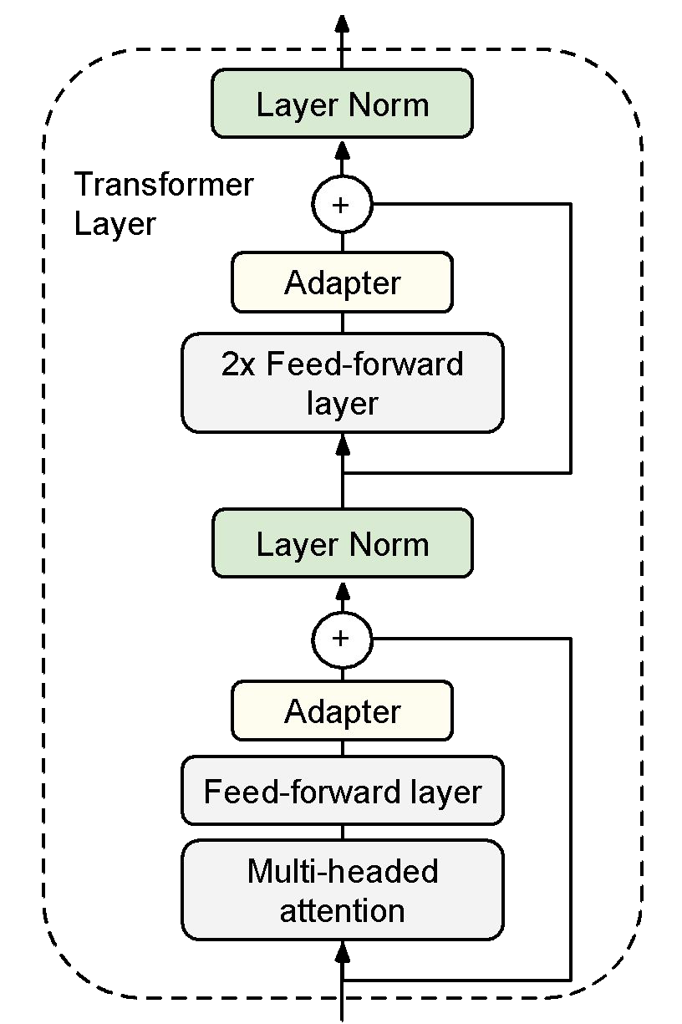
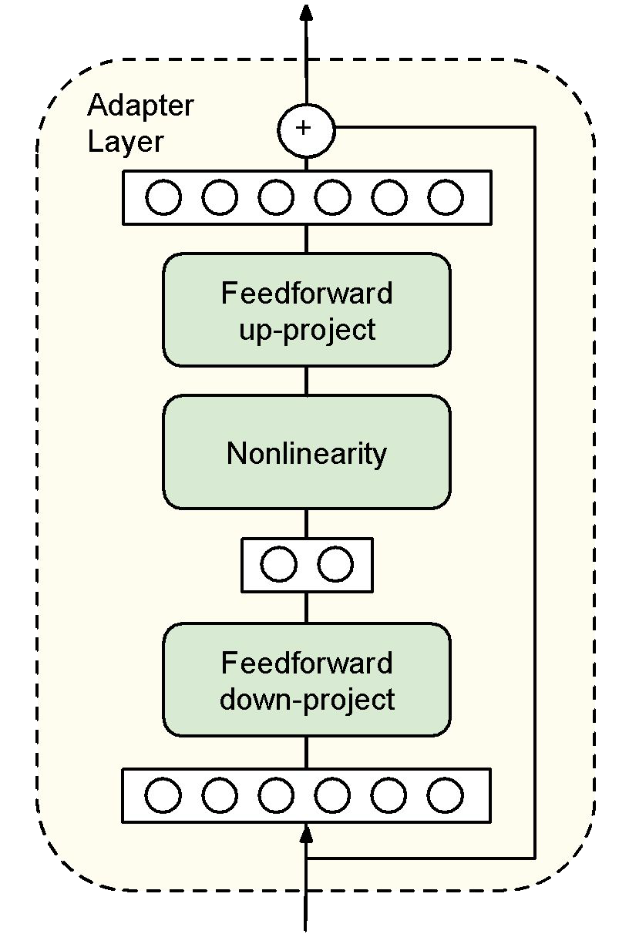
What are adapters?
“Parameter-Efficient Transfer Learning for NLP.” Houslby et al. 2019.

Slide 19
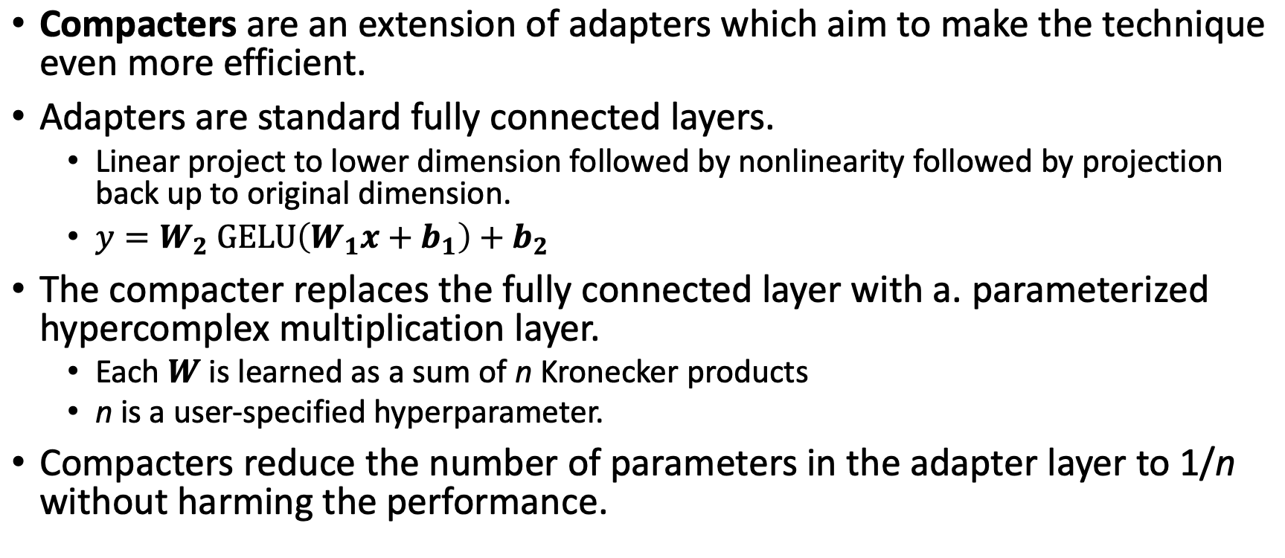
What are compacters?
•
“COMPACTER: Efficient Low-Rank Hypercomplex Adapter Layers.” Mahabadi et al. 2021.

Slide 20
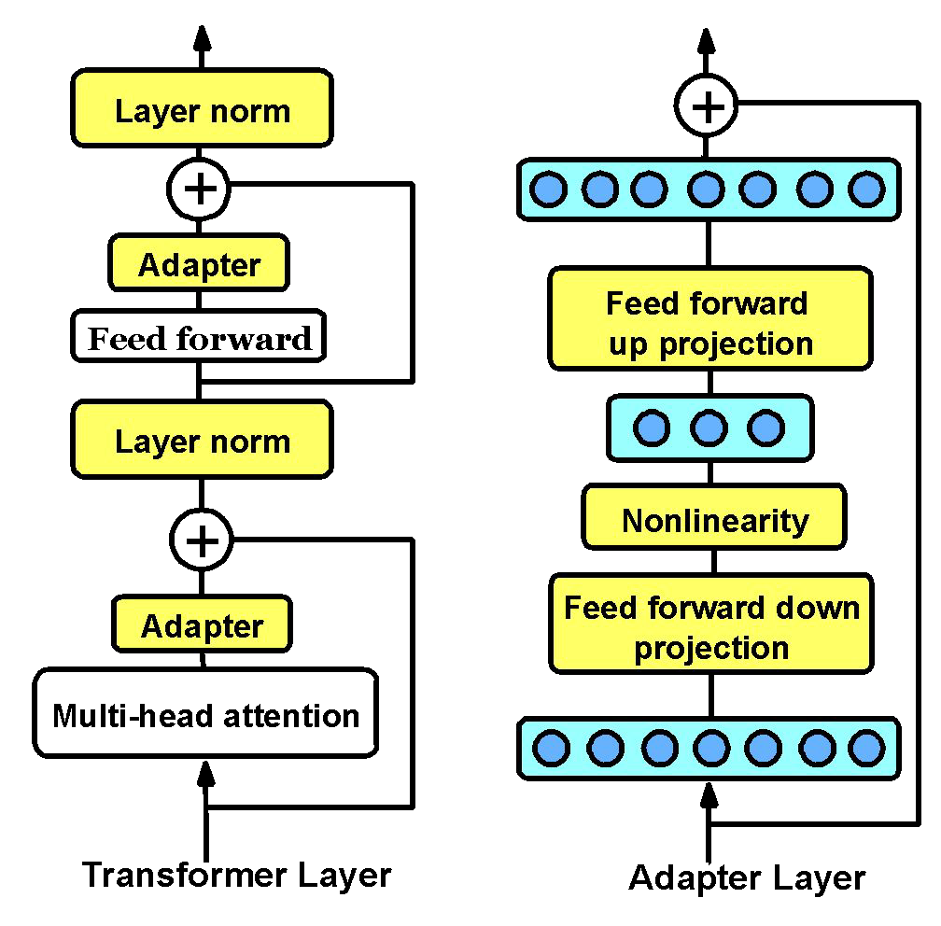
What are compacters?
“COMPACTER: Efficient Low-Rank Hypercomplex Adapter Layers.” Mahabadi et al. 2021.

Slide 21
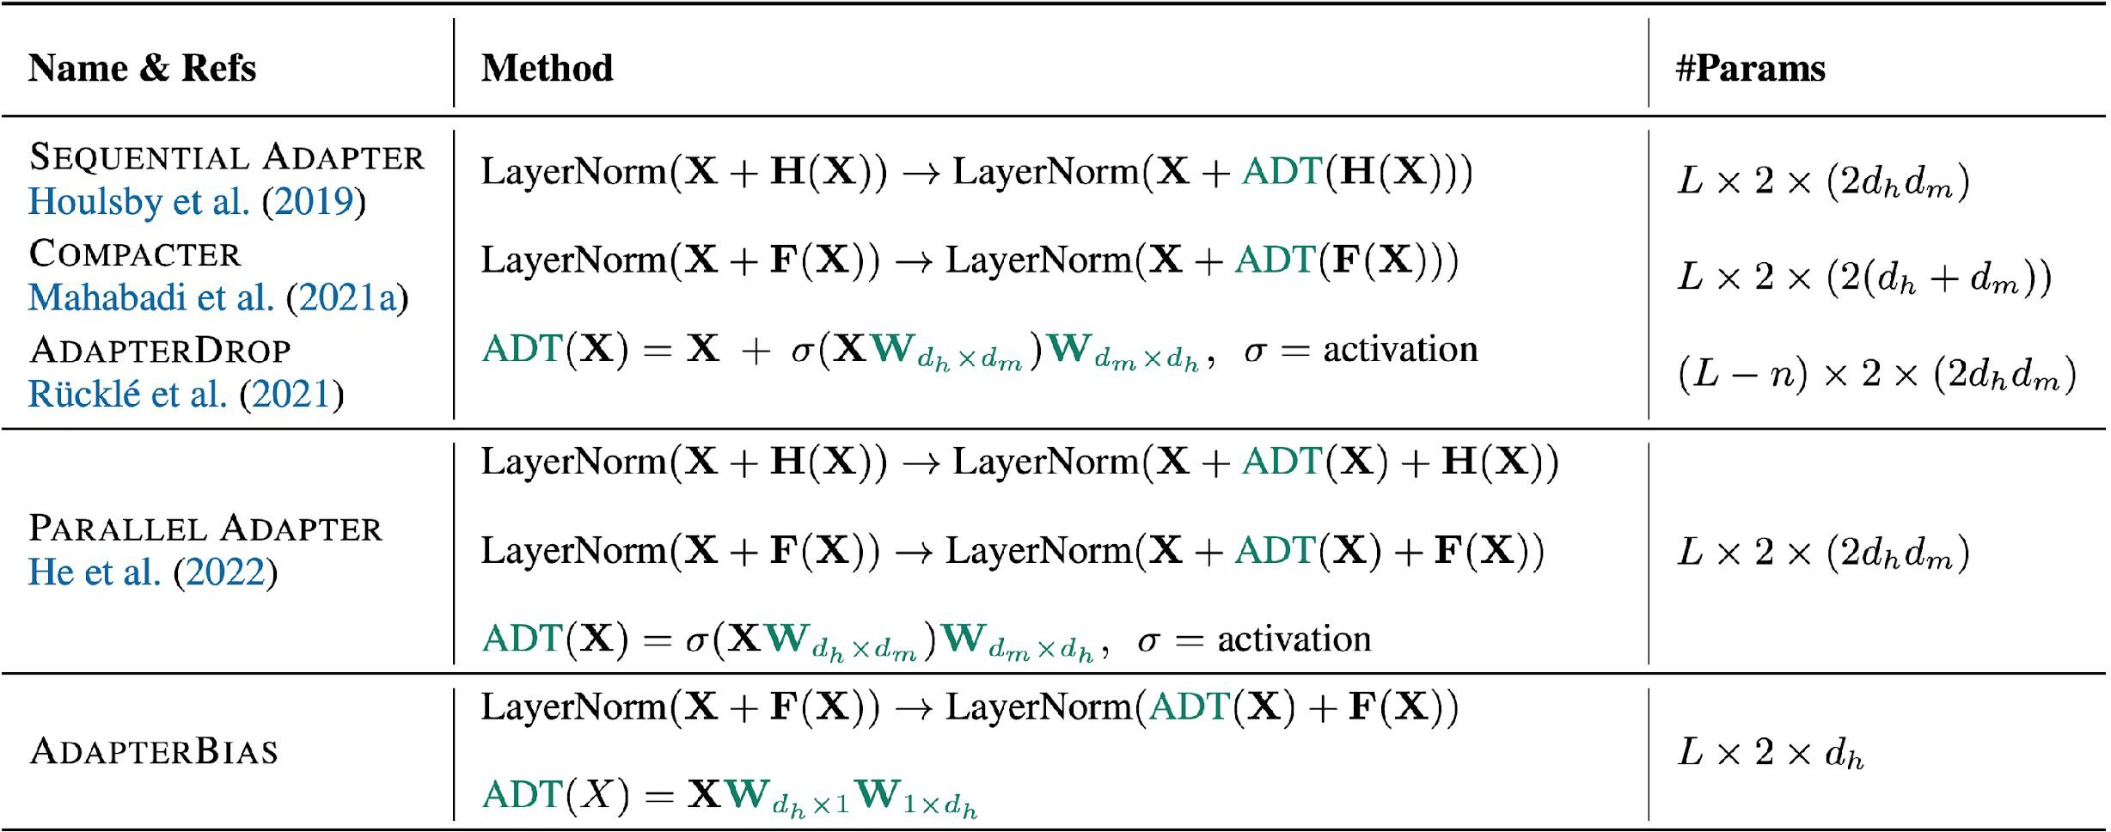
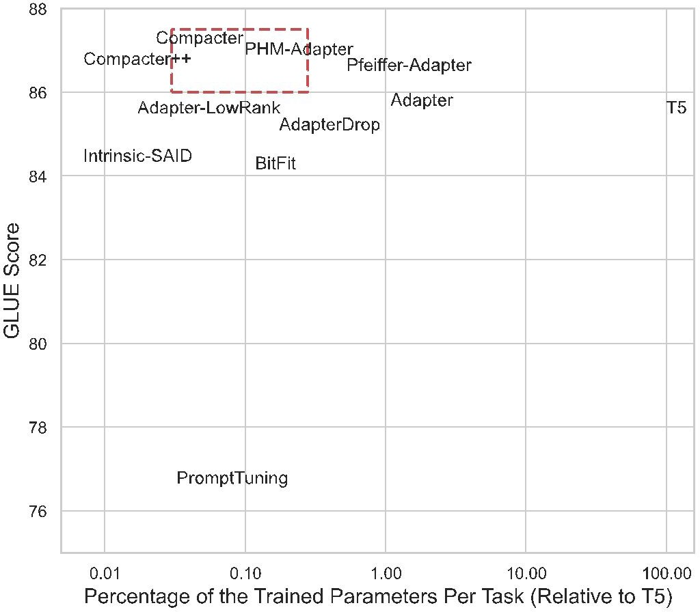
There have been many other extensions to adapters which we won’t discuss in this class.
“COMPACTER: Efficient Low-Rank Hypercomplex Adapter Layers.” Mahabadi et al. 2021.

Slide 22
Advantages of Adapter-Based Methods
Have been shown to be quite effective in multi-task settings.
  There are methods for training task-specific adapters and then combining the to leverage the cross-task knowledge (see AdapterFusion).
Tend to be faster to tune than full model finetuning.
Possibly more robust to adversarial perturbations of the tuning data than full model finetuning.
  (see robust transfer learning paper)

Slide 23
Pitfalls or Adapter Methods
Adding in new layers means making inference slower.
It also makes the model bigger (possibly harder to fit on available GPUs).
Adapter layers need to be processed sequentially at inference time, which can break model parallelism.

Slide 24
What if we pick a small subset of the parameters of the neural network and just tune those?
Methods we’ll discuss: layer freezing, BitFit, diff pruning

Slide 25
Layer Freezing
Research has shown that earlier layers of the Transformer tend to capture linguistic phenomena and basic language understand; later layers are where the task-specific learning happens.
This means we should be able to learn new tasks by freezing the earlier layers and just tuning the later ones.

Slide 26
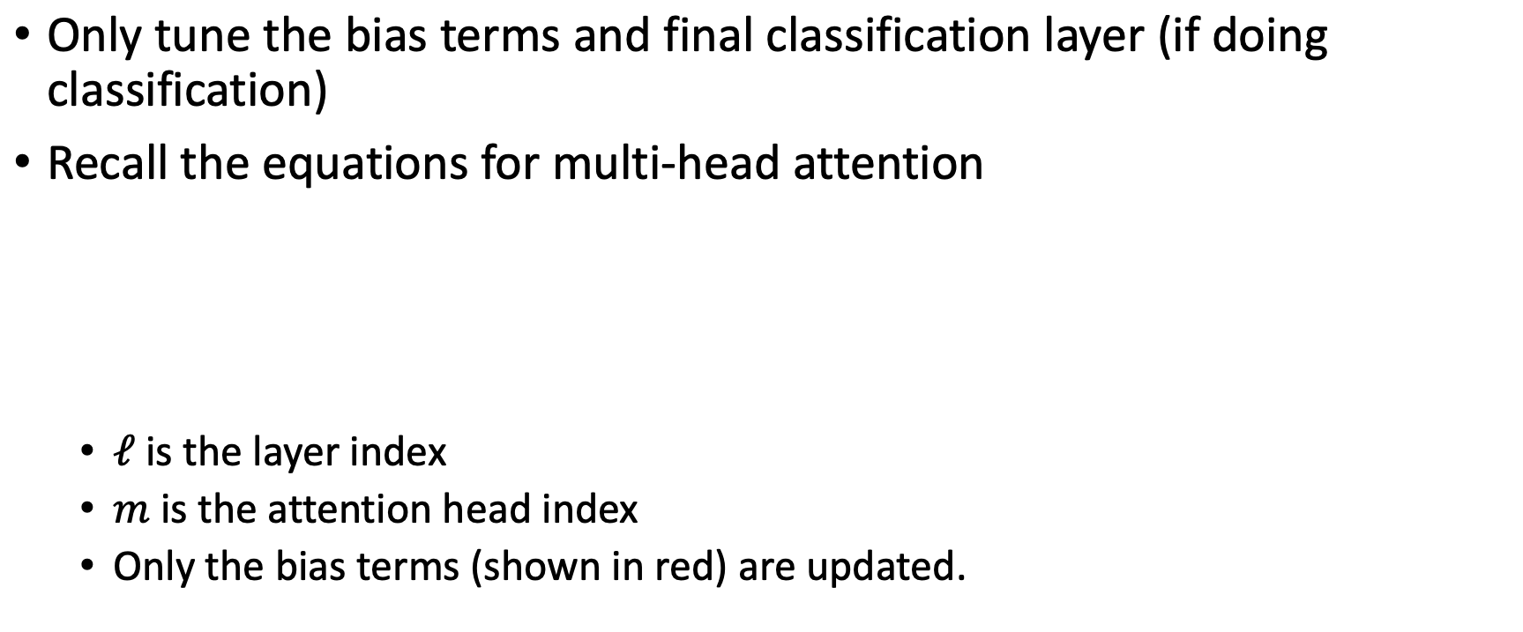
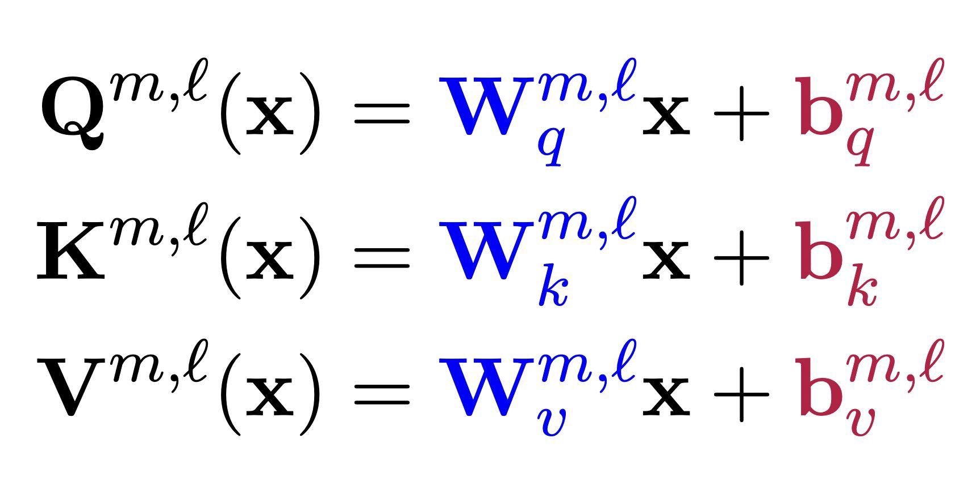
BitFit: Bias-terms Fine-tuning
•
“BitFit: Simple Parameter-efficient Fine-tuning for Transformer-based Masked Language-models.” Zaken et al. 2022.

Slide 27
Intuition for DiffPruning
In prior methods we discussed, the choice of what parameters to freeze and what parameters to tune was done manually.
Why not learn this instead?
Main idea:
  For each parameter, finetune a learnable “delta” which gets added to the original parameter value.
  Use an L -norm penalty to encourage sparsity in the deltas.
0
“Parameter-Efficient Transfer Learning with Diff Pruning.” Guo et al. 2021.

Slide 28
What if we re-parameterize the model into something that is more efficient to train?
Methods we’ll discuss: LoRa, (IA)³

Slide 29
Intuition for Re-Parameterizing the Model
Finetuning has a low intrinsic dimension, that is, the minimum number of parameters needed to be modified to reach satisfactory performance is not very large.
This means, we can reparameterize a subset of the original model parameters with low-dimensional proxy parameters, and just optimize the proxy.

Slide 30
What do we mean by intrinsic dimension?
An objective function’s intrinsic dimension measures the minimum number of parameters needed to reach a satisfactory solution to the objective.
Can also be thought of as the lowest dimensional subspace in which one can optimize the original objective function to within a certain level of approximation error.

Slide 31
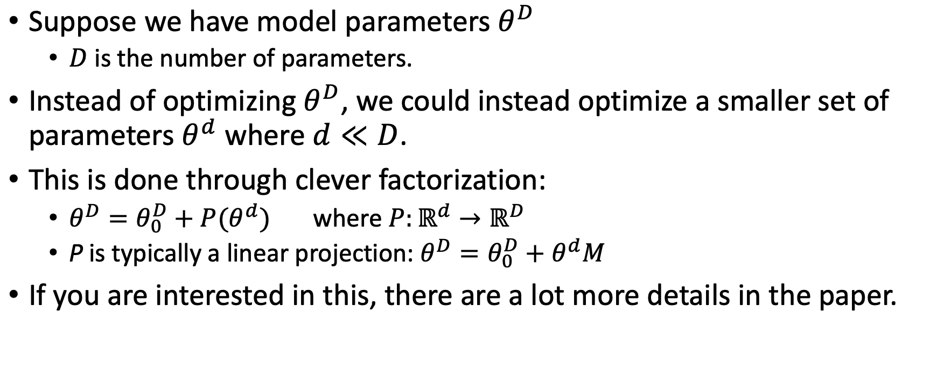
What do we mean by intrinsic dimension?
•
“Intrinsic Dimensionality Explains the Effectiveness of Language Model Fine-Tuning.” Aghajanyan et al. 2021.

Slide 32
LoRA: Low Rank Adaption
Intuition: It’s not just the model weights that are low rank, updates to the model weights are also low-rank.
LoRA freezes the pretrained model weights and injects trainable rank decomposition matrices into each layer.
Like DiffPruning, we are learning a delta to apply to each weight. In the case of LoRA, this delta has been re-paramaterized to be lower dimension than the original model parameters.
In practice, LoRA only adapts the attention weights and keeps the rest of the Transformer as-is.
“LoRA: Low-Rank Adaptation of Large Language Models.” Hu et al. 2021.

Slide 33
(IA)³: Infused Adapter by Inhibiting and
Amplifying Inner Activations
Intended to be an improved over LoRA
Three goals:
  must add or update as few parameters as possible to avoid incurring storage and memory costs
  should achieve strong accuracy after training on only a few examples of a new tasks
  must allow for mixed-task batches
Main idea:
  Rescale inner activations with lower-dimensional learned vectors, which are injected into the attention and feedforward modules
Main differences from LoRA:
  LoRA learns low-rank updates to the attention weights
  (IA)³ learns injectable vectors.
“Few-Shot Parameter-Efficient Fine-Tuning is Better and Cheaper than In-Context Learning.” Liu at al. 2022.

Slide 34
Advantages of Re-Paramaterization Methods
Training tends to be more memory-efficient, since we only need to calculate gradients and maintain optimizer state for a small number of parameters.
These methods are faster to tune than standard full model finetuning.
It is straight-forward to swap between tasks by swapping in and our just the tuned weights.

Slide 35

Summary

Slide 36
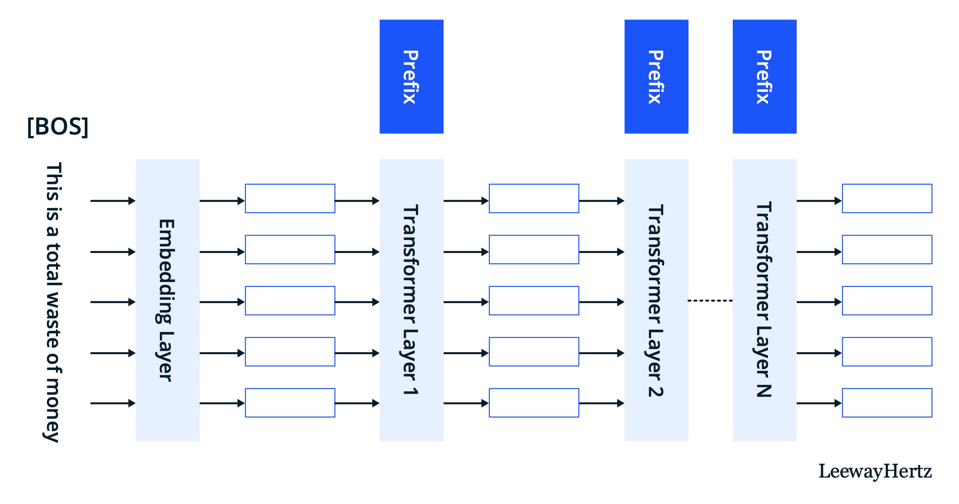
Prefix Tuning
https://www.leewayhertz.com/parameter-efficient-fine-tuning/

Slide 37

Prompt Tuning
https://www.leewayhertz.com/parameter-efficient-fine-tuning/

Slide 38
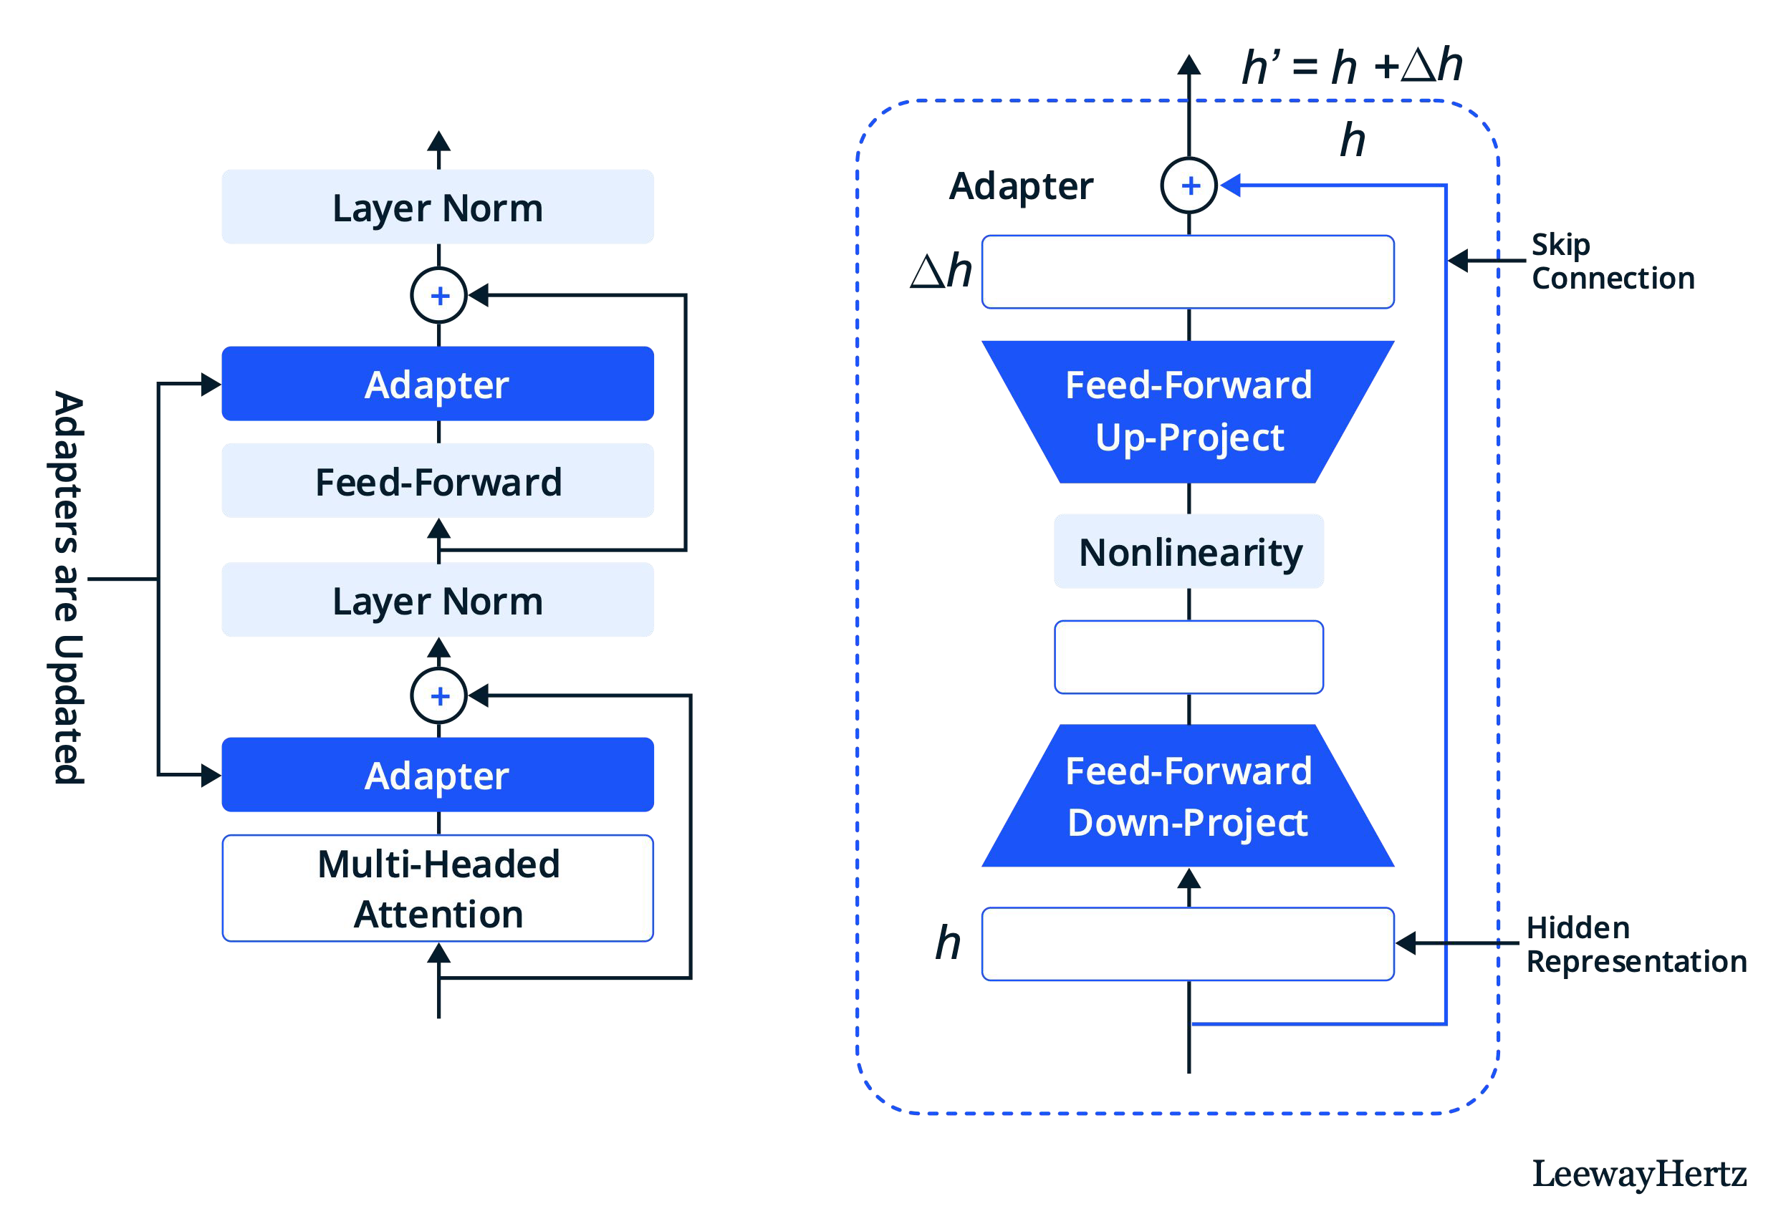
Adapters: adding in new trainable layers
https://www.leewayhertz.com/parameter-efficient-fine-tuning/

Slide 39


LoRA: injecting trainable rank decomposition matrices
https://www.leewayhertz.com/parameter-efficient-fine-tuning/

Slide 40
Training Subset of Existing Parameters
Manually chose what to tune
  Just tune the last few layers
  Just tune the bias terms (BitFit)
Learn which parameters need to be tuned (DiffPruning)

Slide 41
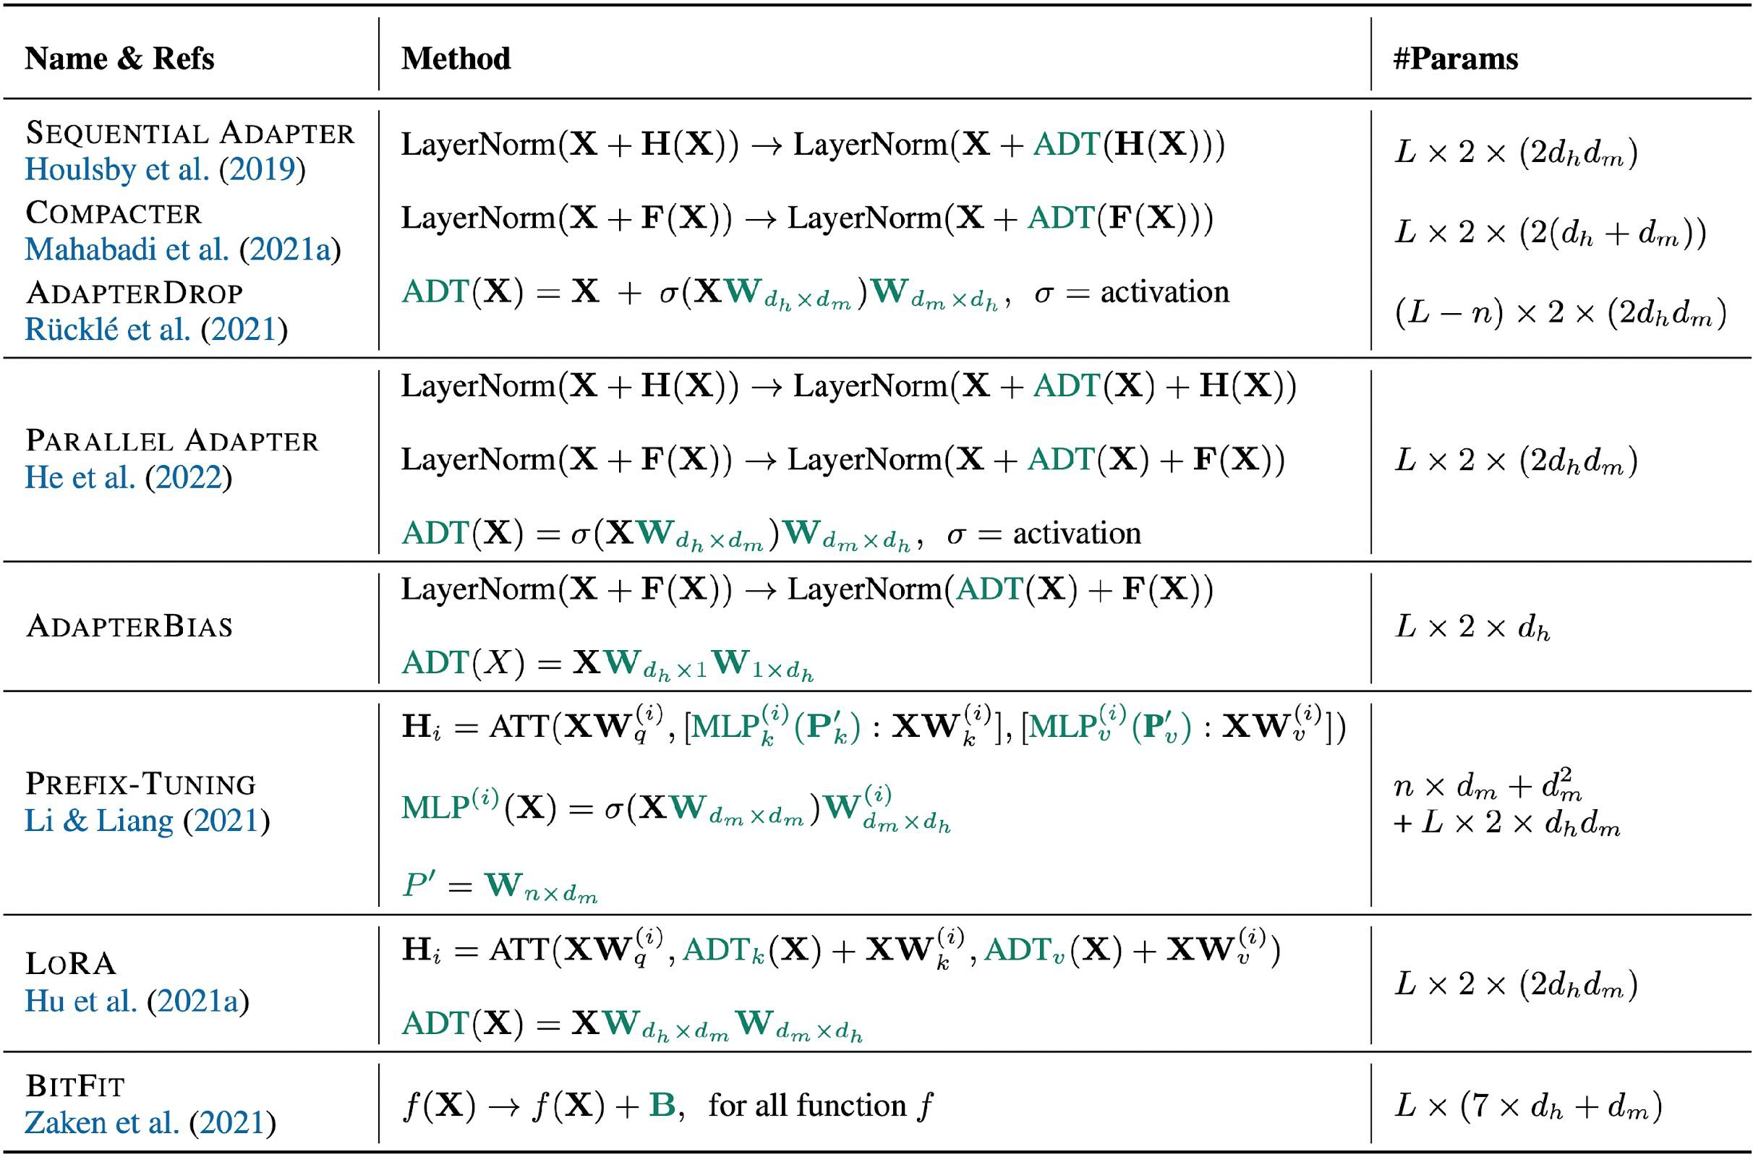
Summary
“Delta Tuning: A Comprehensive Study of Parameter Efficient Methods for Pre-trained Language Models.” Ding et al. 2023.

Slide 42
Results

Slide 43
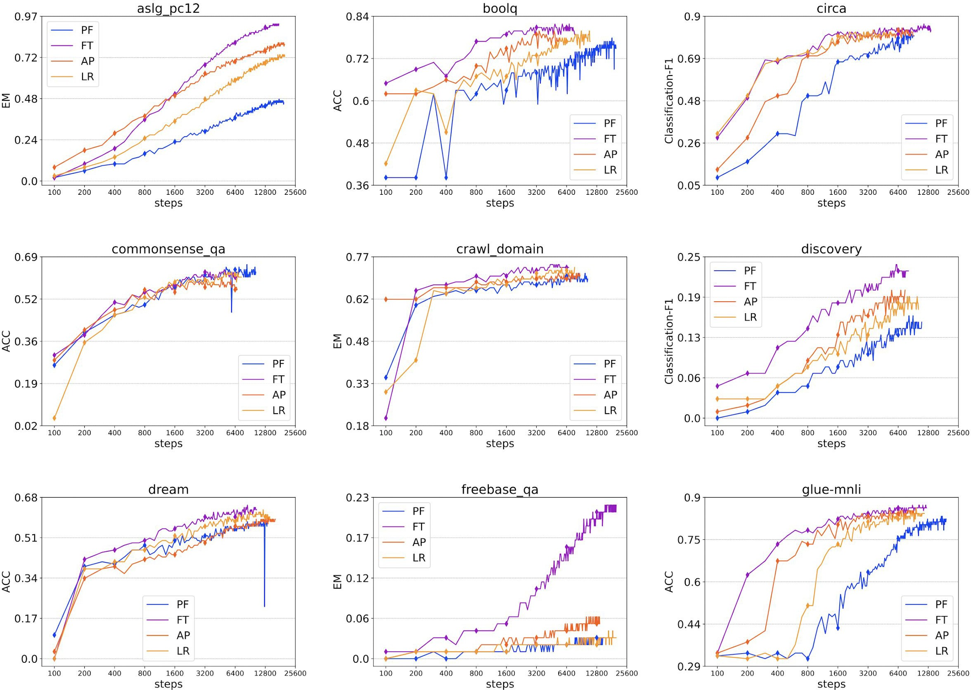
If you have the resources, full fine-tuning tends to work the best.
PF: prefix tuning FT: full fine-tuning AP: adapter
LR: LoRA
This survey overall found:
Full fine-tuning > LoRA >
Adapters > Prefix Tuning > Prompt Tuning
In terms of performance.
Plots for many more tasks can be found in the paper.
“Delta Tuning: A Comprehensive Study of Parameter Efficient Methods for Pre-trained Language Models.” Ding et al. 2023.

Slide 44
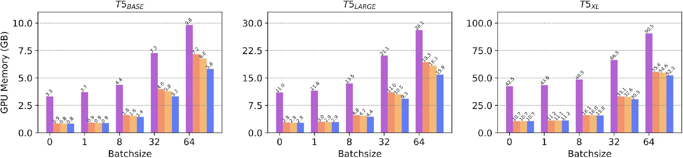
What does memory usage look like?
FT: full fine-tuning AP: adapter
LR: LoRA
BF: BitFit
Prompt tuning and prefix tuning not included because they use the same amount of memory as full fine-tuning
“Delta Tuning: A Comprehensive Study of Parameter Efficient Methods for Pre-trained Language Models.” Ding et al. 2023.

Slide 45
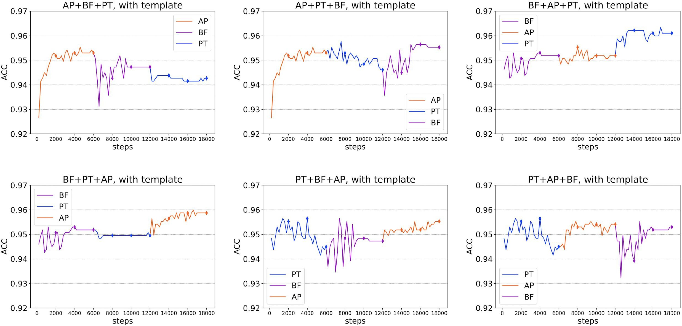
Can the methods be combined?
FT: BitFit AP: adapter
PT: prompt tuning
Results on SST-2 sentiment classification
“Delta Tuning: A Comprehensive Study of Parameter Efficient Methods for Pre-trained Language Models.” Ding et al. 2023.

Slide 46
Options Available to You

Slide 47
How can you use parameter-efficient tuning?
OpenAI finetuning API
  It is extremely likely they are using a version of one of the methods described.
  Unfortunately, we can only rely on speculation.
  Models available: gpt-3.5-turbo-0613, babbage-002, and davinci-002
HuggingFace PETM Library
  LoRA, prefix tuning, prompt tuning, and (IA)³ all implemented.
  Several different models available to be adapted.

Slide 48
Quiz Question
Suppose you want your LM to be able to perform two different tasks.
You could use prompt tuning to tune a separate prompt for each task.
Or you could tune a single prompt for both tasks simultaneously.
Under what circumstances might one of these approaches work better than the other?

